Slide 1
Navajo Integrator
Portal Back-office integration
Arjen Schoneveld
Dexels BV

Slide 2
Introduction
Problem scope: portal ←→ back-office integration complexity
The Solution
  Approach 1 (SOAP RPC oriented)
  Approach 2 (SOAP document oriented)
Navajo framework
Demo
Features
Implementation

Slide 3
Problem scope
Multitude of coupling technologies between back-office and portal
    Maintenance problems
    Specific technical knowledge required
Lack of Robustness
    Technical alterations in back-office (e.g., database normalizations) systems result in necessary adaptations in portal
Lack of functional knowledge separation
    Portal Developers need thorough knowledge of back-office (e.g., data models)

Slide 4
Current situation
HTML
Portal
PC
Multitude of coupling technologies
ODBC/JDBC, DCOM, CORBA, EJB, Proprietary APIs
Legacy Apps/Databases/ERP

Slide 5
Solution
HTML
Portal
PC
Disparate applications
Application Universal Interface
Uniform XML interface
Legacy Apps/Databases/ERP

Slide 6
Approach 1
Use RPC level web service coupling between portal and IML
One type of transport and syntactic protocol (e.g. HTTP/XML)
Clear separation required knowledge
    Back office developers responsible for creating web services in the IML, Portal developers simply use these web services
Multitude of coupling technologies
Lack of Robustness
No functional knowledge seperation
Solves problem 1,
Solves problem 2
Leaves problem 3 open.
Semantic abstraction level too low

Slide 7
Approach 2
Use form level web service coupling between portal and IML
Uses higher abstraction level
    Back-office data in uniform format
    Semantic level IML interface language lifted to highest possible abstraction level without endangering the required flexibility
Lack of Robustness
No functional knowledge seperation
Multitude of coupling technologies
Solves problem 1,
Solves problem 2
Solves problem 3
Additional advantage: Component based construction

Slide 8
Framework
Flexibility
HTML
PC
Portal
Adaptability
Disparate applications
Uniform Connector
XML Form
Navajo
Script logic
Navajo Form
Java
Validation rules
Navajo Script
FORALL([/coverage/fund.*/value], `([$x] == 0)
OR ([$x] >= 10)`)
[insurance/enddate] < ([person/date_of_birth] + 80#0#0)
Navajo Adapters
<map object="com.creditcompany.CreditCheck">
<field name="name">
<expression value="ToUpper([/koper/naam]) + '_check_'"/>
</field>
<message name="person">
<property type="date" name="date_of_birth"
description="" value="1970-1-1" direction="in">
<property type="selection" name="gender"....
Legacy Apps/Databases/ERP

Slide 9
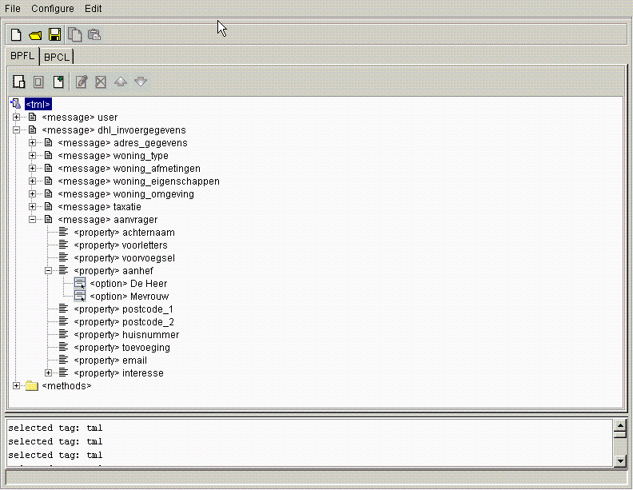
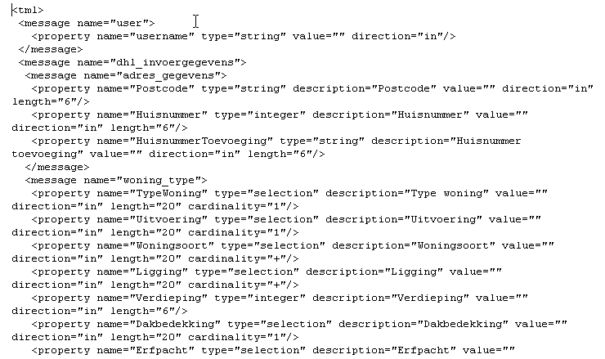
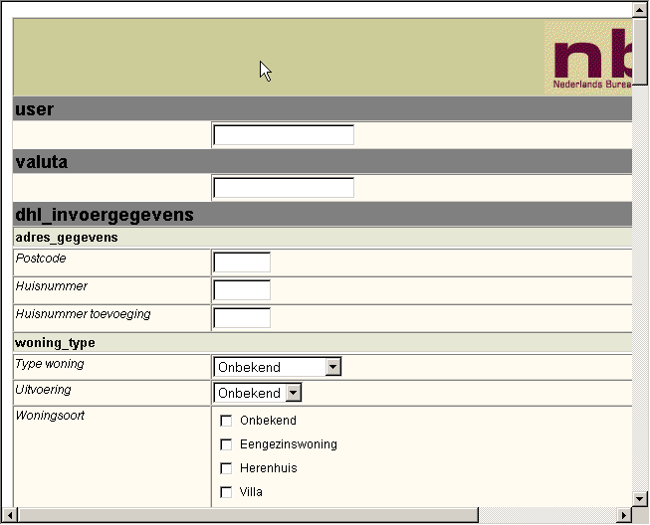
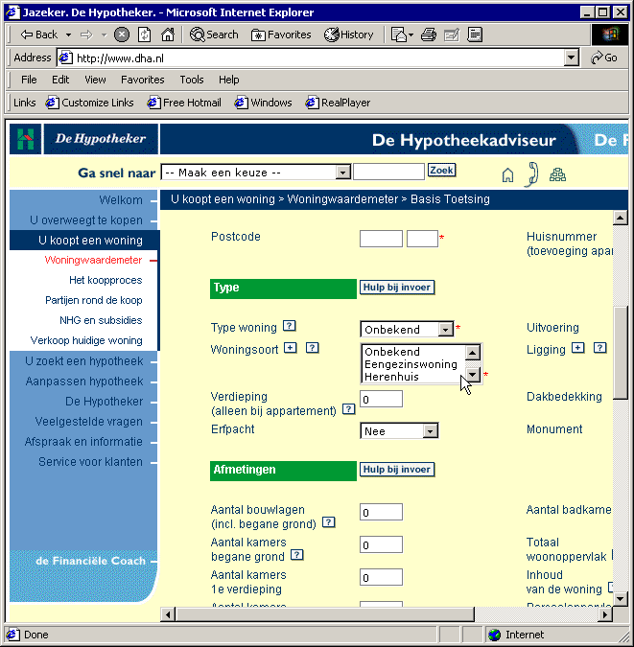
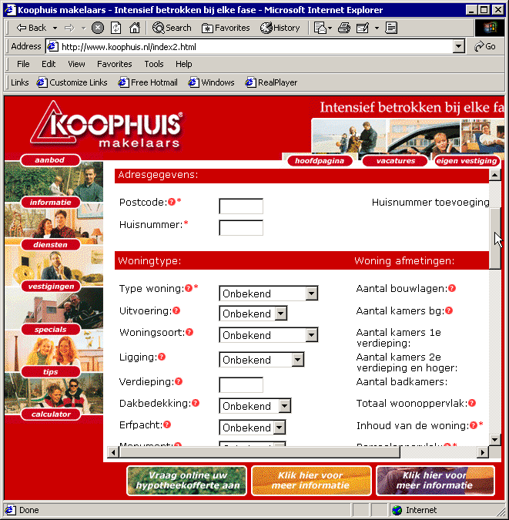
Navajo in a nutshell
Studio view
XML view
HTML client view
Usage Client I
Usage client II

Slide 10
Features
Web service and user management
Business rule engine
Business rule management
Web service personalization
Business process flow engine
Graphical web service development/deployment tool
Built-in general SQL connector
Built-in business functions
SDK for building new business functions
SDK for building new connectors
SDK for building low level web services
Single XML schema based
Fully JAXP 1.1 compliant
Supports JAXM SOAP messages
SSL support (X509 certificates)
Built-in XML/HTTP, SOAP/HTTP and XML/SMTP listeners
SDK for building new listeners
Supports any Servlet 2.2 compliant Java (J2EE) application server
Generic web service test client

Slide 11
Navajo benefits
Clear separation responsibilities and knowledge
Portal integration includes “free” application integration
Fast implementation of web services
Layered architecture supports best-of-breed approach
Based on the adagium of “Occam’s razor”
New revenue opportunities
Faster Time-to-market

Slide 12
Implementation
1 day installation
Supports ANY J2EE (EJB container not neccessary) compliant application server:
  IBM websphere
  BEA weblogic
  Oracle 9i AS
  …
  Tomcat
  Orion

